Slide 1
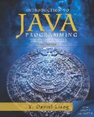
Introduction to Computer Programming II
Interfaces

Slide 2
The Java Interface
A contract
Defined externally to the classes
Called for in the base class
Implemented in the derived classes
Notes:
The designers of C/C++ did the same thing with the keyword ‘static’

Slide 3

Motivation
A set of derived classes will have a common base class…
The class designer visualizes that all derived classes will have a common method.
The interface ensures that all derived classes will provide the common method.

Slide 4
Remember....
Java does not support multiple inheritance
The interface construct is supposed to offer an alternative.

Slide 5
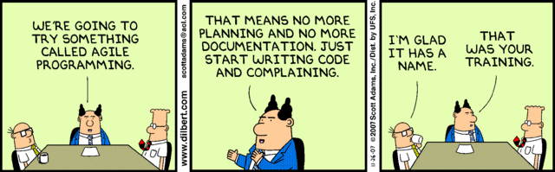
Therefore…
You can’t inherit from the base class unless you implement the interface.
Notes:
The Dilbert is not relevant to the slide, I just think it’s hilarious.

Slide 6
Recall a ‘Method Signature”
No code, just 3 things
Method name
Argument list (data types)
Return data type

Slide 7
Some Examples
public int Alpha();
public void Beta(int delta);
public Random Foo();
Notes:
Be sure you can interpret method signatures.

Slide 8
A Pure Abstract Class
public abstract class BaseClass implements InterfaceDemo
{
// This is a pure abstract class.
// Nothing here at all.
}
Notes:
Any class that inherits from this must implement the interface.

Slide 9
The Interface
public interface InterfaceDemo {
// This looks suspiciously like a C++ prototype.
// The method has no body,
// just a method signature.
// There's no executable code.
public boolean Build();
}

Slide 10
An Interface you should know
Comparable

Slide 11
The Big Idea
“We all need to sort stuff”
Don’t write your own sort, please.

Slide 12
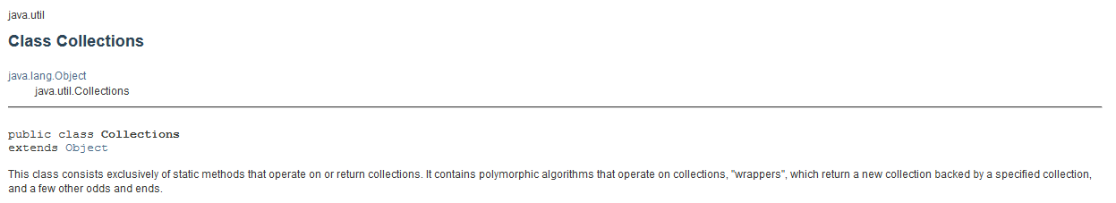
The Collections Class
All static methods
Notes:
http://docs.oracle.com/javase/7/docs/api/java/util/Collections.html

Slide 13
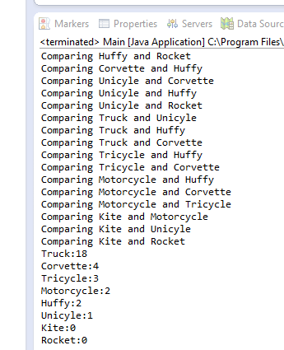
Look at the project TheComparableInterface

Slide 14
The Collections class will sort stuff for us
Notes:
<T> is just a placeholder for a “Type”

Slide 15
Sorting Performance is affected by ...
Number of times the Compare() method is called
Amount of memory that is required
How long the comparison takes
Notes:
Sorting is a field of study in Computer Science

Slide 16
Sorting Minutiae
A Terrible Slide!
“This implementation is a stable, adaptive, iterative mergesort that requires far fewer than n lg(n) comparisons when the input array is partially sorted, while offering the performance of a traditional merge sort when the input array is randomly ordered. If the input array is nearly sorted, the implementation requires approximately n comparisons. Temporary storage requirements vary from a small constant for nearly sorted input arrays to n/2 object references for randomly ordered input arrays. “
Notes:
This is the difference between Computer Science and Information Technology

Slide 17
Deeper Analysis
8 items to compare
16 comparisons
Add another item
How many comparisons ?
A pattern develops !

Slide 18
The cool trick
Collections.sort() works with any list of objects that implelements the Comparable interface
Notes:
Ta Da!

Slide 19
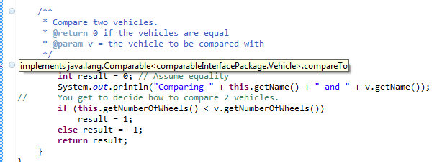
The Interface is fulfilled

Slide 20
What is the comparison?
You decide.

Slide 21
The compare method should return
1 if arg1 > arg2
-1 if arg1 < arg1
0 if arg1 == arg2

Slide 22
Our compare method
/**
* Compare two vehicles.
* @return 0 if the vehicles are equal
* @param v = the vehicle to be compared with
*/
public int compareTo(Vehicle v) {
int result = 0;// Assume equality
System.out.println("Comparing " + this.getName() + " and " + v.getName());
//You get to decide how to compare 2 vehicles.
if (this.getNumberOfWheels() < v.getNumberOfWheels())
result = 1;
else
result = -1;
return result;
}

Slide 23
Overview
1. Create a class that implements Comparable
implements Comparable<className>

Slide 24
Overview
2. Write a public method in the class with this signature:
public int compareTo(className c)
1 if arg1 > arg2
-1 if arg1 < arg1
0 if arg1 == arg2

Slide 25
Overview
3. Create an array (List) of your objects
4. Call Collections.sort()
5. Kick back

Slide 26
References

